Slide 1

MED-SAM and UNet for Surgical Tool Segmentation: A Comparative Analysis
452 Final
Lola Assad, Jackson Reid, Adam Cockell
Notes:
Lola + all

Slide 2
Slides Contain Surgical Images Ahead
Notes:
Lola

Slide 3
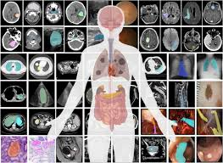
Motivation
Image segmentation in the medical field
Use Cases
Diagnosis
Disease Monitoring
Tumour Detection/ and Monitoring
Tissue identification
Anomaly and Artifact Detection
Pathological Cancer Screening
Cell Growth Tracking
Etc….
Impact
Notes:
Lola

Slide 4
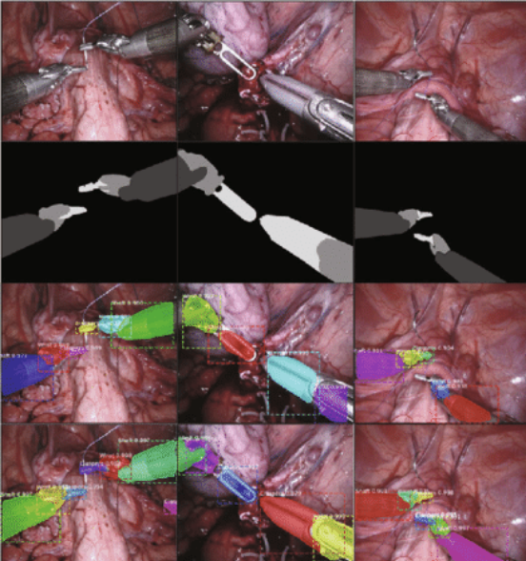
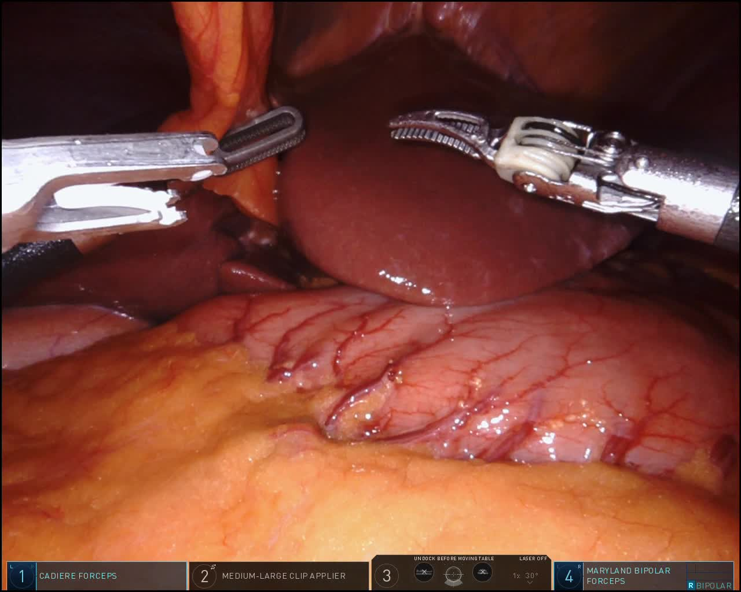
Project Description
Surgical tool segmentation
Med SAM & UNet comparative analysis
Notes:
Lola

Slide 5
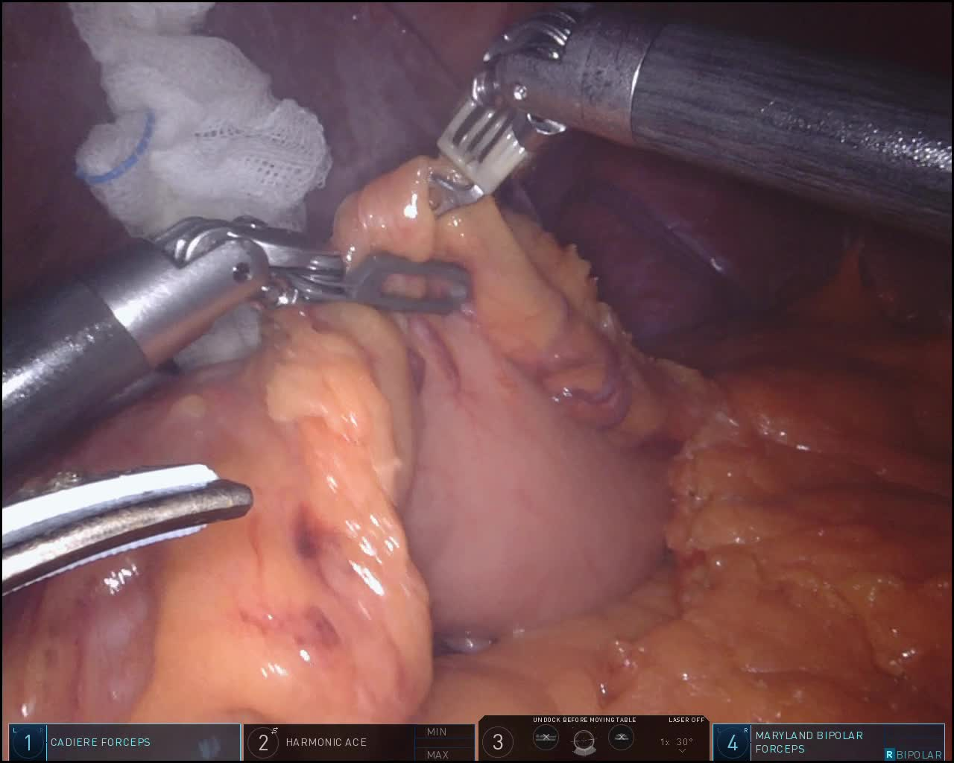
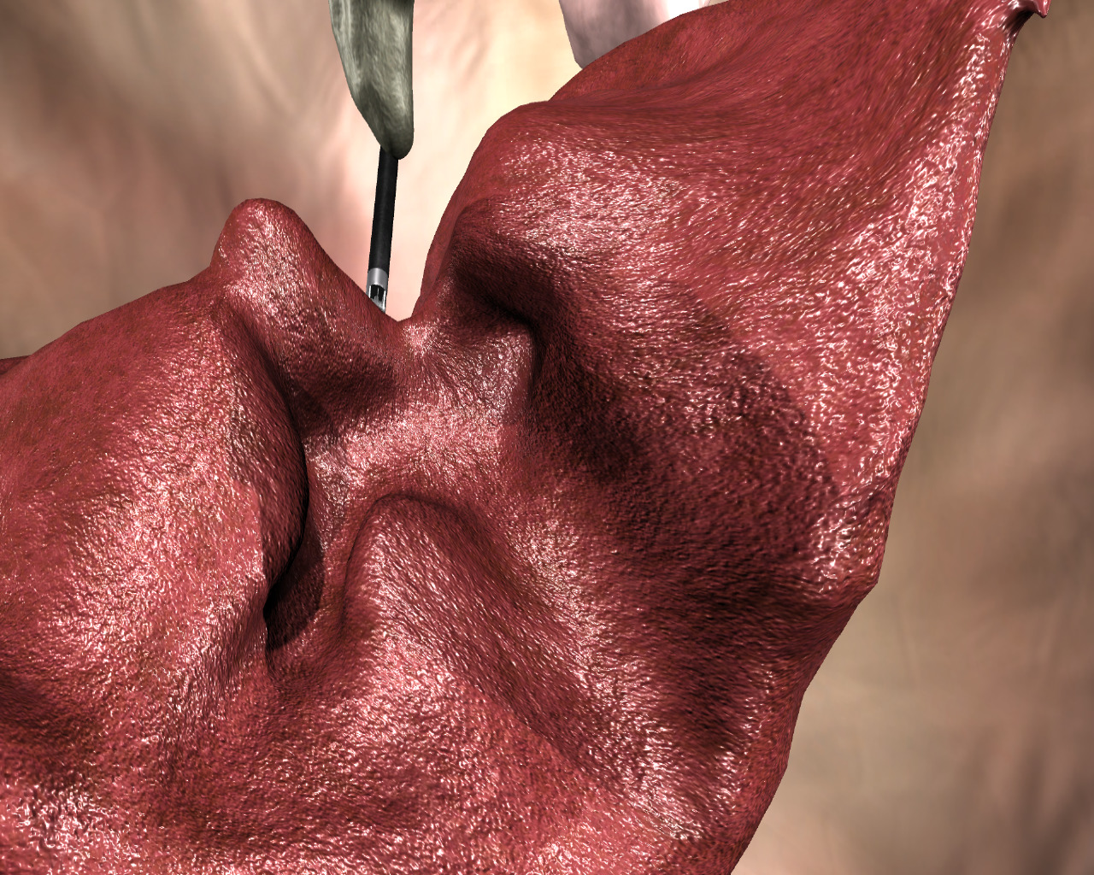
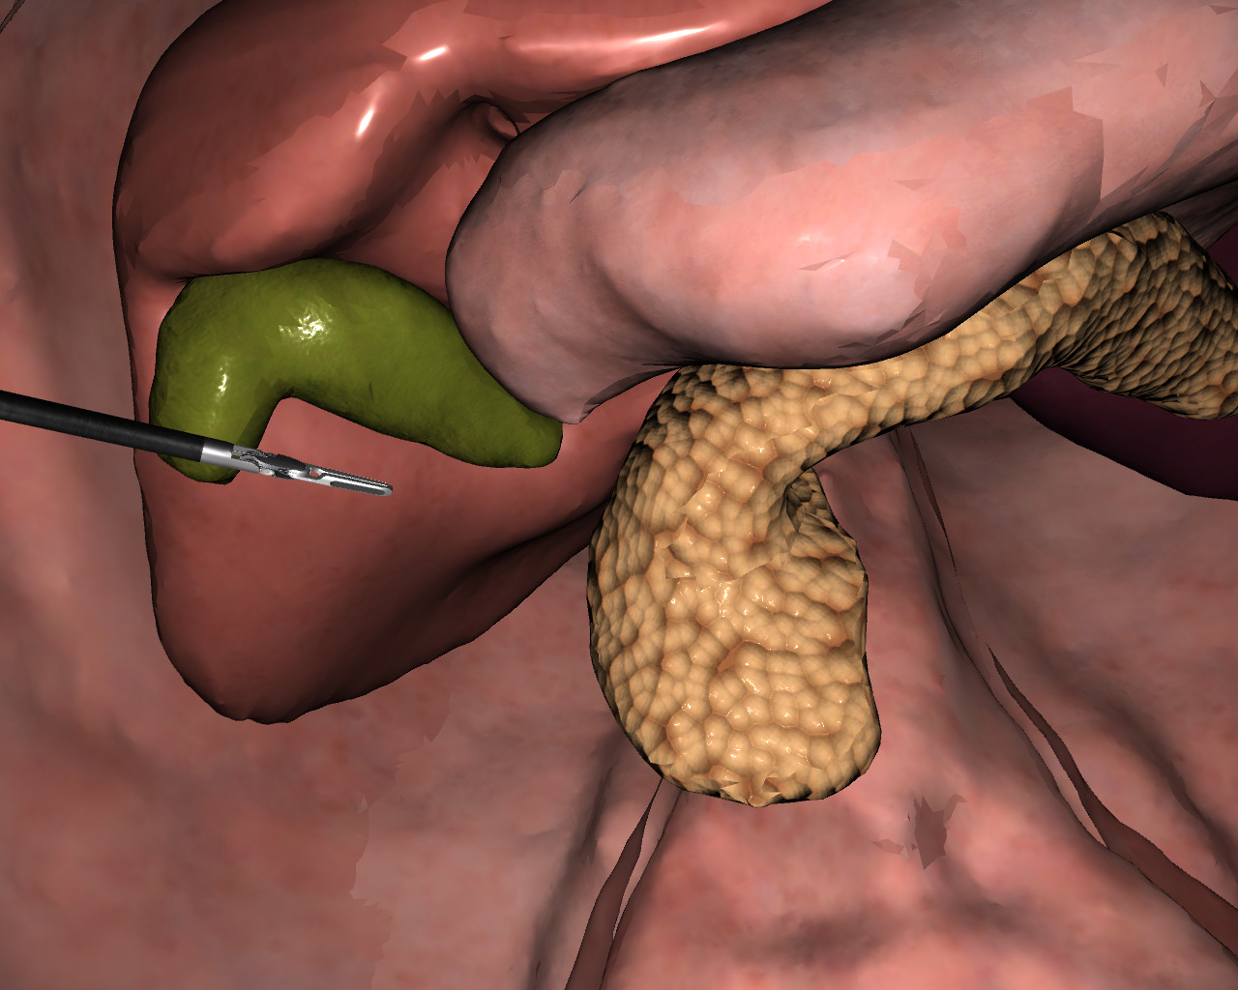
Specific Problem Reviewed
A specific problem the team reviewed
Using the same dataset, researchers developed a model for the scene segmentation of the DaVinci surgical procedures using both real image data, and 3D simulation data at MICCAI 2022
Their goal included accurate surgical scene 3D renditions
They then published this dataset on Kaggle for public use
Notes:
Lola

Slide 6
Reference Study for MED-SAM
“Segment Anything in Medical Images”
Aimed to use MED-SAM as a general segmentation tool
Accuracy varies with image clarity
Notes:
Jackson
The study “Segment Anything in Medical Images” was referenced when building our MED-SAM model.
This study investigates the performance of MED-SAM across a diverse range of medical segmentation tasks.
The goal was to build a single model that could segment a wide variety of medical images from different modalities such as an X-ray, MRI, and CT scan.
With this, the accuracy was compared with state of the art medical image segmentation models. In comparison, MED-SAM performed inconsistently, with significant variation in accuracy depending upon the specific imaging context.
MED-SAM performed exceptionally well when faced with images containing distinct borders, but struggled with images that had less defined boundaries.

Slide 7
U-Net Reference Study
“Medical Image Segmentation Using Automatic Optimized U-Net Architecture Based on Genetic Algorithm"
This study aimed to improve U-Net performance using a genetic algorithm
Notes:
Jackson
https://www.mdpi.com/2075-4426/13/9/1298
The goal of this study was to improve the performance of U-Net in medical image segmentation tasks by updating and optimizing its architecture using a genetic algorithm.
The algorithm would explore various U-Net configurations, and select the optimal design for a certain segmentation task.
These models were assessed using the Dice similarity coefficient and the Intersection over Union metrics to measure accuracy
The optimized architecture achieved higher accuracy than the baseline model, showing how effective genetic algorithms can be in enhancing model performance.
This model reduces the necessity for manual tuning, but adds serious complexity to the algorithm.

Slide 8
Another U-Net Reference Study
"Half-UNet: A Simplified U-Net Architecture for Medical Image Segmentation"
Notes:
Jackson
The main goal of this study was to reduce the complexity of the U-Net architecture, aiming to decrease the number of parameters and the computational demands, while maintaining or improving performance.
Half-Unet simplifies the encoder and decoder components of UNet by unifying the channel number, implementing full-scale feature fusion, and incorporating ghost modules to streamline the network
Half-UNet achieves segmentation accuracy similar to the original UNet as well as some of its variants.
Regarding its goal of reduction, it decreased parameters by 98.8% and floating point operation by 81.6% compared to the standard UNet
This helps a lot with complexity, but greatly hinders the generalization potential of UNet, demanding the model to undergo extra validation than normally required.

Slide 9
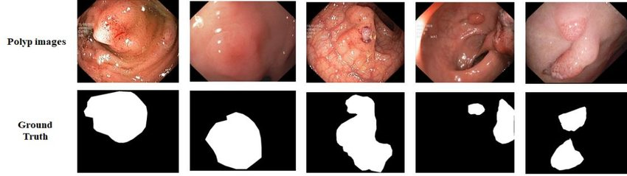
Similar Datasets
Kvasir-SEG Dataset (https://www.kaggle.com/datasets/debeshjha1/kvasirseg)
TotalSegmentator Dataset (https://github.com/wasserth/TotalSegmentator)
Promise12 Dataset (https://paperswithcode.com/dataset/promise12)
Notes:
Jackson
A few datasets similar to the one we chose are the kvasir-seg, totalSegmentator, and promise12 datasets.
The Kvasir-SEG is an open-access dataset comprised of gastrointestinal polyp images, all with corresponding segmentation masks. They are all manually annotated and verified by medical professionals.
The TotalSegmentator dataset is a large dataset containing over 100,000 annotations across 104 anatomical structures, all derived from CT images.
The Promise12 dataset is made up of T2-weighted MRI scans from 50 patients with various diseases, all acquired at different locations using different MRI vendors and scanning protocols.

Slide 10
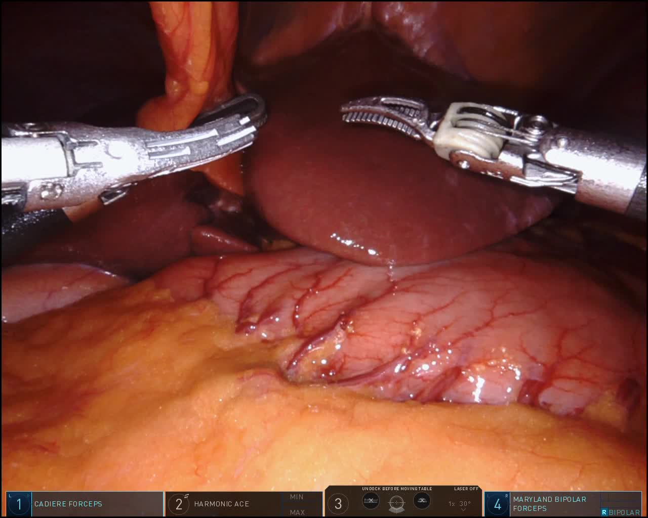
Our Dataset
Surgical Scene Segmentation in Robotic Gastrectomy
https://www.kaggle.com/datasets/yjh4374/sisvse-dataset/data
Notes:
Jackson
We chose this dataset because of how relevant it is to surgical AI research. The data includes images from three cross validation sets of real image data considering demographic and clinical information from 40 real surgical videos of gastrectomy.
Having so much real, high quality data allows for the development of AI models for precise surgical instrument detection and segmentation. This is very important for improving the accuracy of computer assisted surgical tasks.
With more accurate segmentation also makes it much more plausible to create systems that avoid unintentional damage to the patient, which is a currently a large issue with computer assisted surgery.
This dataset also includes highly accurate image masks which makes supervised learning much easier to train models that need to be extremely precise and accurate.

Slide 11
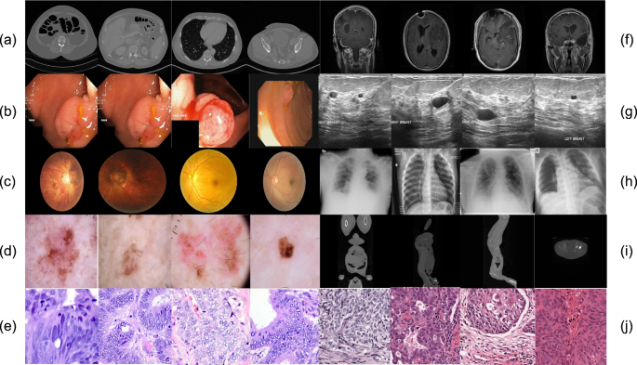
What is Med SAM
Segment Anything Model fine-tuned for usage in the medical imaging domain
Developed by the Bo Wang laboratory at the University of Toronto
Notes:
Lola

Slide 12
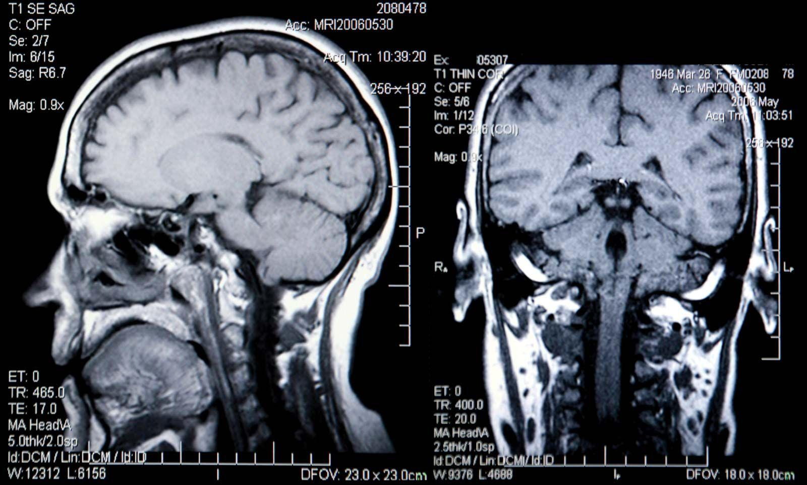
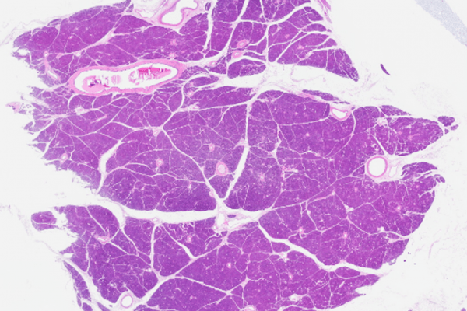
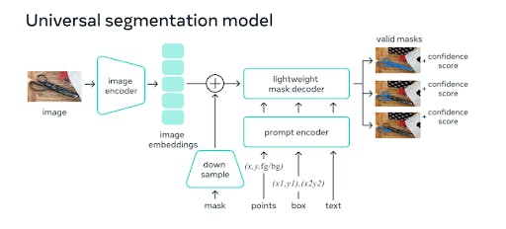
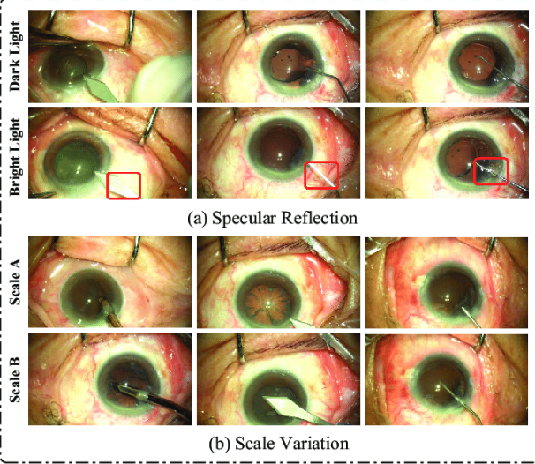
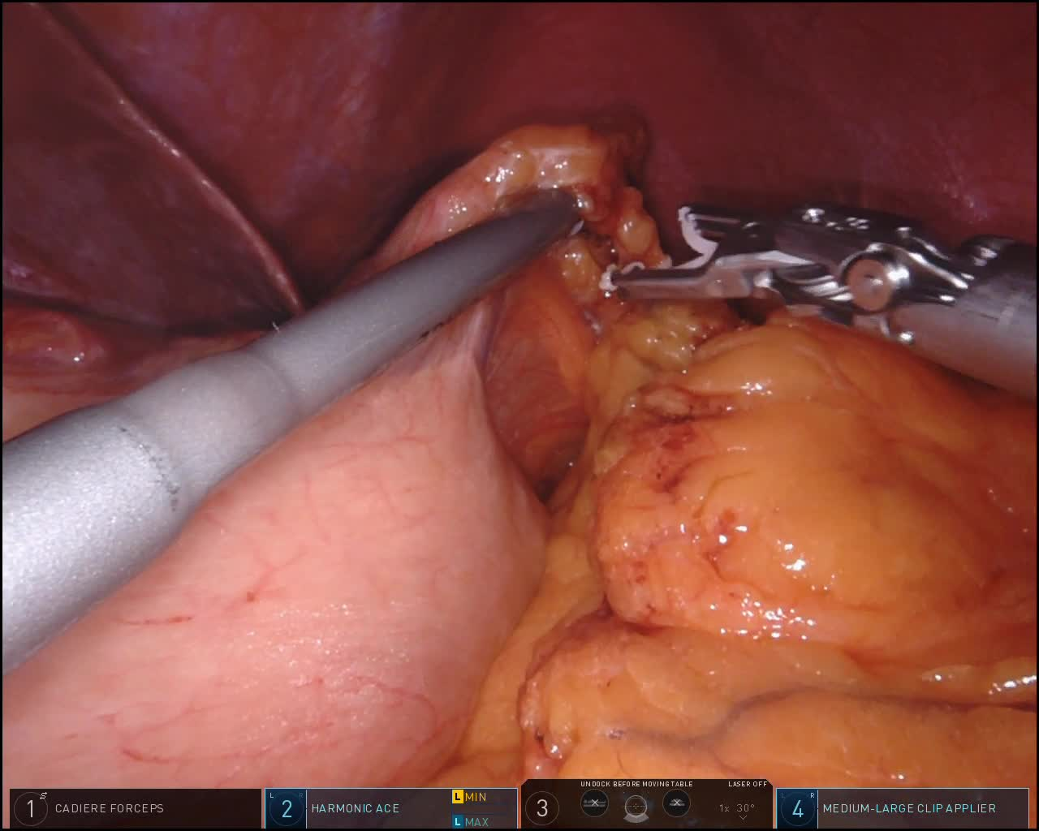
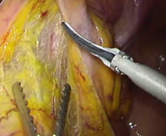
Med SAM Architecture
Notes:
Lola

Slide 13
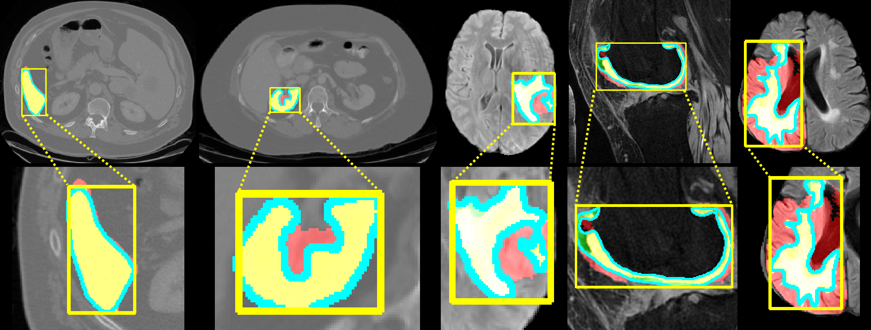
Why We Chose Med SAM
Open Source
Sufficient Documentation
Fine Tuned Segment Anything Model
Available GUI support
Notes:
Lola

Slide 14
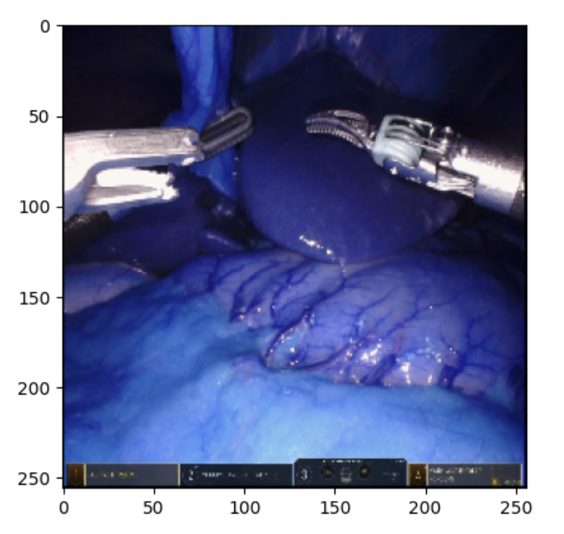
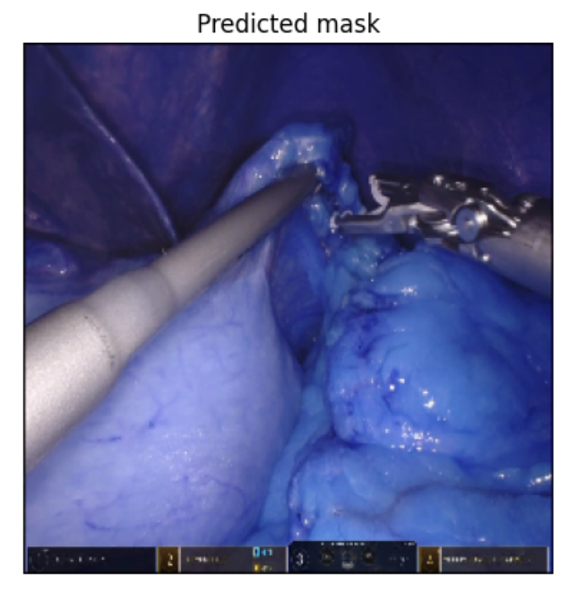
Results I: Tool Segmentation Using Med SAM
Notes:
Lola

Slide 15
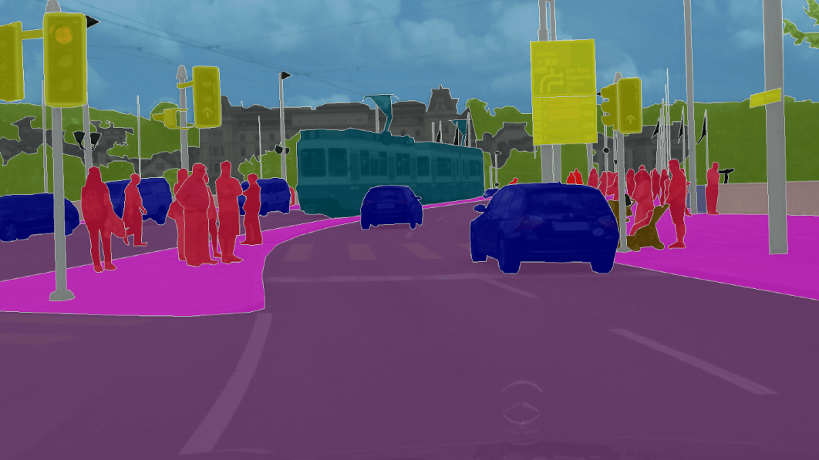
What is U-Net
U-Net is a CNN
It segments images by classifying pixels
Notes:
Jackson
Unet is a convolutional neural network designed for semantic image segmentation
It was originally designed for biomedical images, but has evolved to be used for other tasks as well.
U-Net segments on a pixel basis. It separates each into a specific category in order to classify sections of an image.
It is best suited for tasks that require precise bounding of regions in an image.
It is commonly used for medical imaging, autonomous driving, and satellite imaging

Slide 16

U-Net Architecture
U-Net is a CNN Made up of:
Encoder
Bottleneck
Decoder
Output Layer
Notes:
Adam
U-net is a convolutional neural network made up of four layers:
The first is the encoder, whose purpose is to extract features and reduce an images dimension.
The second is the bottleneck that connects the encoder and decoder paths in order to capture very abstract features in the images.
The third is the decoder which recovers the resolution for segmentation maps.
Finally the output layer reduces the features to the required number of classes in order to produce a pixel-based classification map that categorizes the input image.

Slide 17

Why we chose U-Net
It is meant for segmentation
U-Net is very applicable in Biomedical Settings
Computationally efficient
Notes:
Adam
We chose U-net because it is very effective in tasks that require pixel-level precision, making it perfect for segmenting surgical tools.
U-Net has been historically successfully in biomedical image segmentation, as it was originally designed for that. It has been extensively tested in similar use cases like tumor detection and organ segmentation.
Most importantly, it has a very balanced design which helps it to be computationally efficient, making it possible to train our vast dataset.

Slide 18

Results II: U-Net
The finished U-Net code with results was only on one device which stopped working earlier today when we were finishing the slide-show. If we can’t get it to work soon, we will take it to Canada Computers and Electric to repair the device and retrieve the results.
Results will be delivered ASAP.

Slide 19
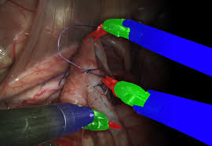
Future Directions
Our Next Steps for the Project:
Fixing UNet Results technical issue before final submission
Getting a mask on the surgical tool itself with Med SAM
Getting numerical results to accompany out final results for the final report

Slide 20
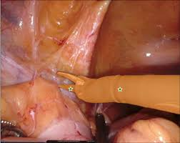
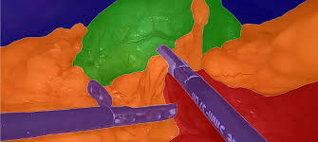
Conclusion
We found that Med-SAM was efficient and effective in segmentation of the DavinCi surgical tools in relation to organic tissue

